Slide 1

Adequate
An Open-Source Web Development Framework.

Slide 2
What is Adequate?
Adequate is a free open-source PHP web framework, created by Gerald Nika and intended for the development of web applications following the model-view-controller (MVC) architectural pattern.
Adequate offers an expressive and elegant syntax, helping you develop more fluently and without errors.

Slide 3
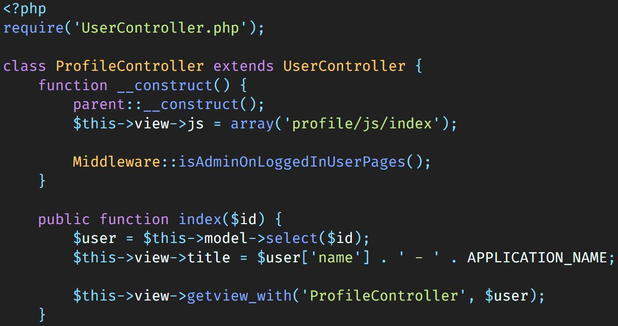
Why Adequate?
Expressive & beautiful syntax.
Elegance, simplicity, and readability.

Slide 4
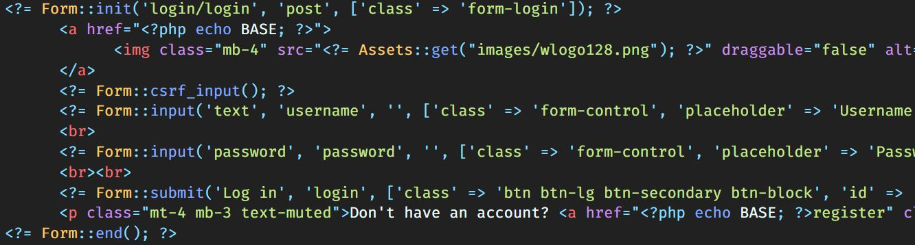
Why Adequate?
Bunch of helpful tools.
Adequate comes with a bunch of tools, to help you develop faster, keep things clean
and avoid syntax errors.

Slide 5
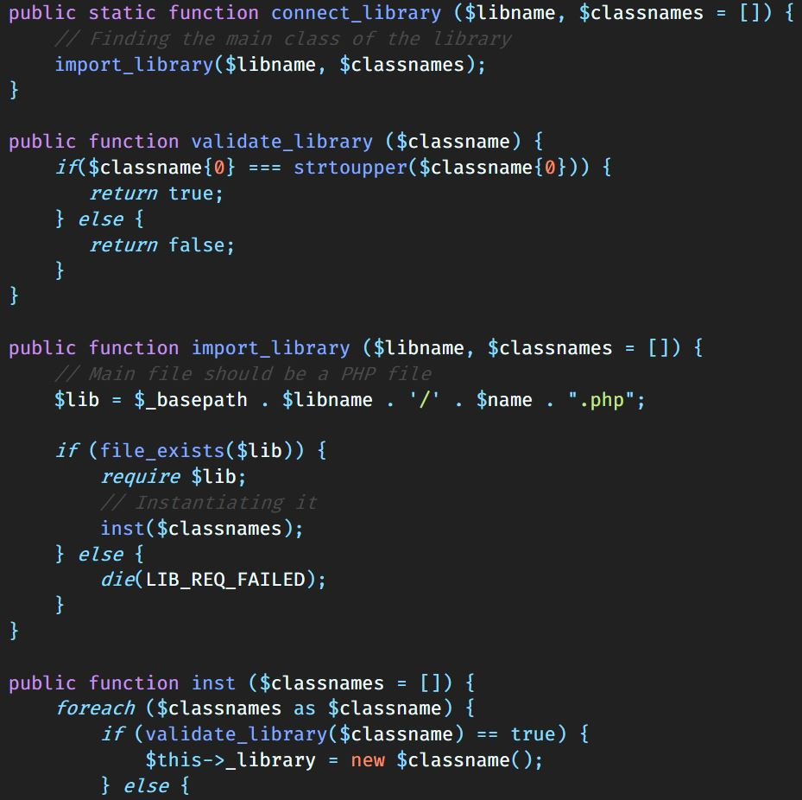
Why Adequate?
Packaging system.
An amazing way to organize your external packages and APIs through our packaging system.

Slide 6
Installation
This general installation procedure will get you a copy of the project up and running on your local machine for development or testing purposes.

Slide 7
Installation (Prerequisites)
To run this software on your local machine you need to have:
A host : OS x64 / x32.
PHP : v.7 or above.
Server type : MariaDB – v.10 or above.
DBMS : MySQL – phpMyAdmin v.4 or above.
OpenSSL PHP Extension.
PDO PHP Extension.
Tokenizer PHP Extension.

Slide 8
Installing Adequate (Deployment)
Open the configurations folder and change in the 'database_params.php' file these fields:
DB_TYPE -> Replace with your database type;
DB_HOST -> Replace with your host address;
DB_NAME -> Replace with your database name;
DB_USERNAME -> Replace with your database username;
DB_PASSWORD -> Replace with your database password;
Open the configurations folder and change in the 'configs.php' file these fields:
HASH_GENERAL_KEY -> Replace with your desired general key;
HASH_PASSWORD_KEY -> Replace with your desired database key;
Create a database record of admin credentials in admin table:
Admins are created in phpMyAdmin manually. You have to encrypt the password with sha256. To do so, get the password from a user you registered through the form and paste it. Then you can change it later in admin profile settings.

Slide 9
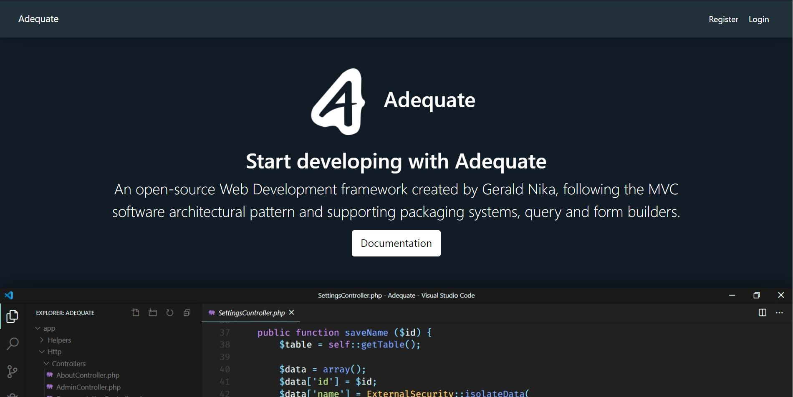
Running the Project
After the installation, place the folder into your local host documents folder and run it by going to 127.0.0.1 or localhost address in your browser.
It should look something like this:

Slide 10
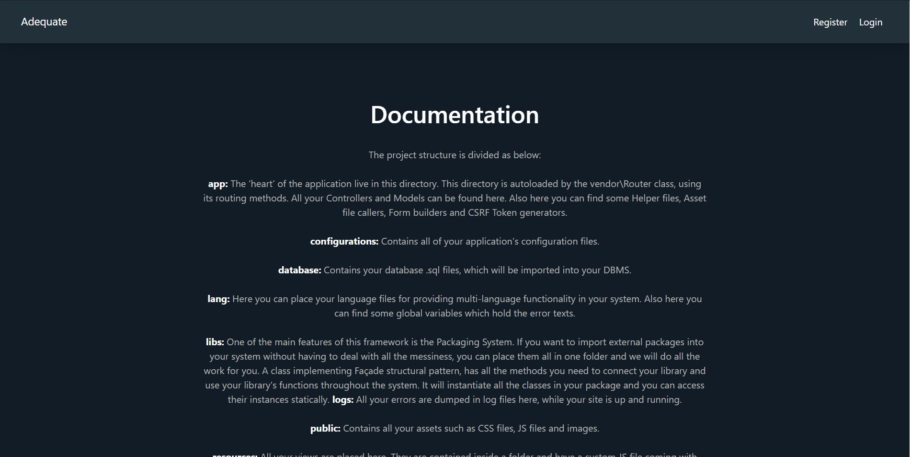
Running the Project
This is the Documentation page.

Slide 11
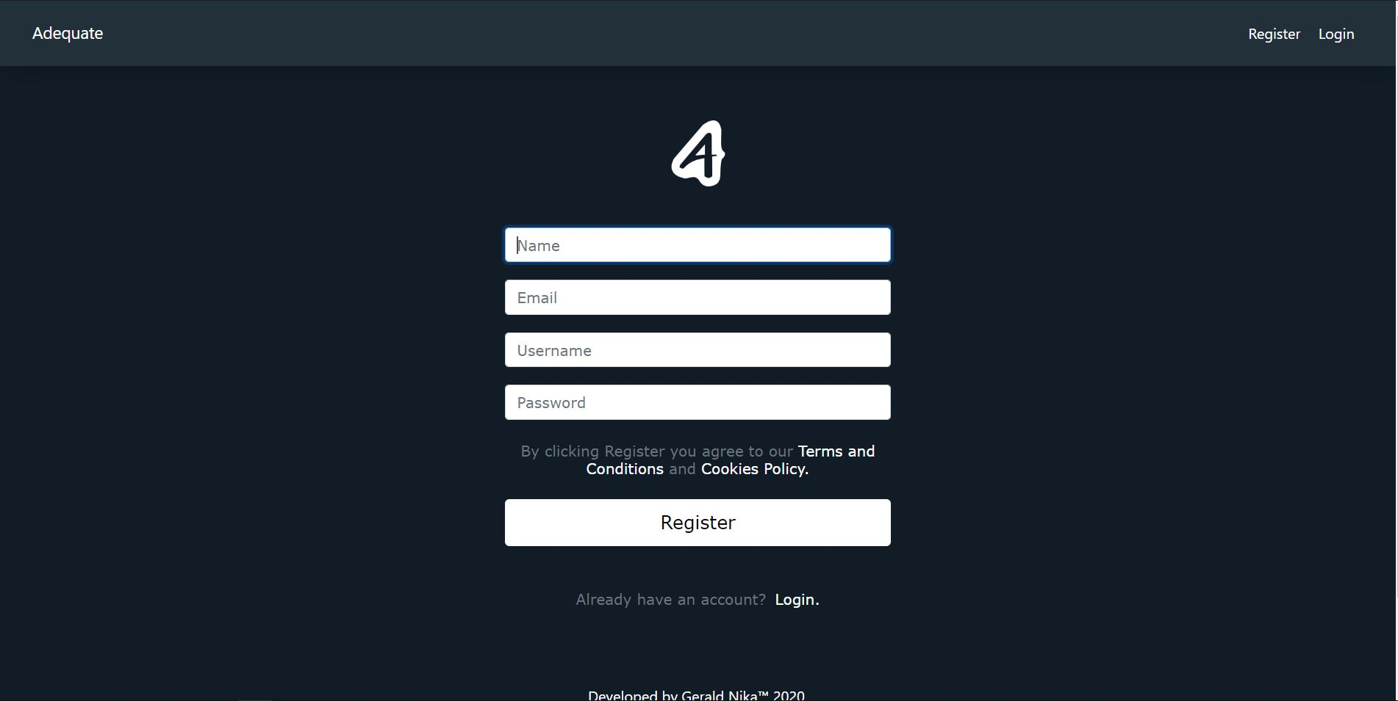
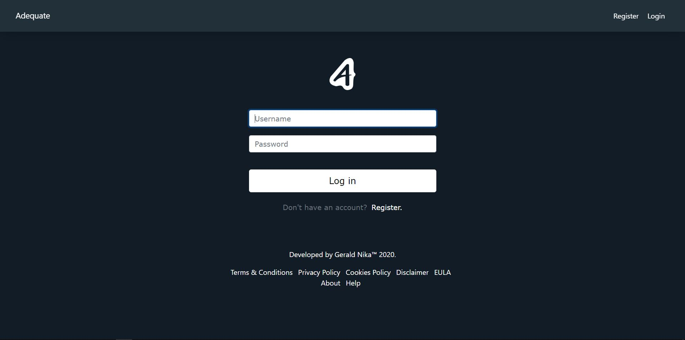
Running the Project
There is also an Authentication system coming with the framework.

Slide 12
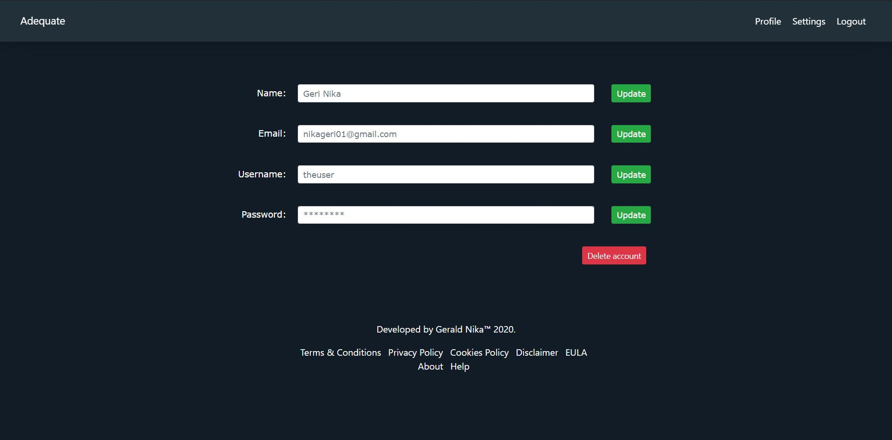
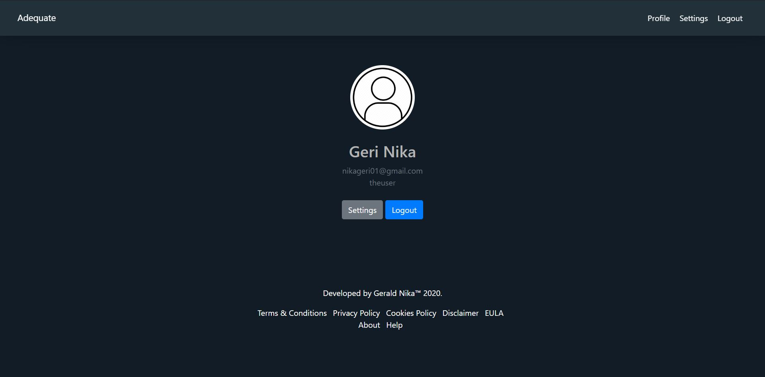
Running the Project
You should be redirected to the user Profile page after logging in or registering.
You can change the user credentials in Settings page.

Slide 13
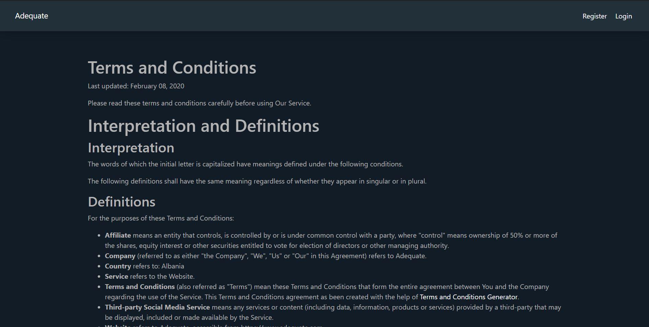
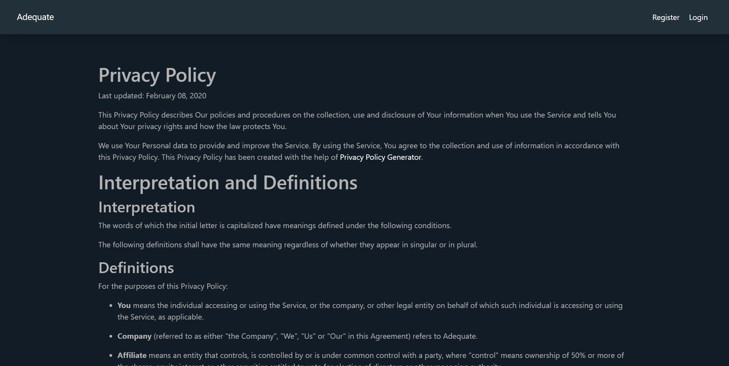
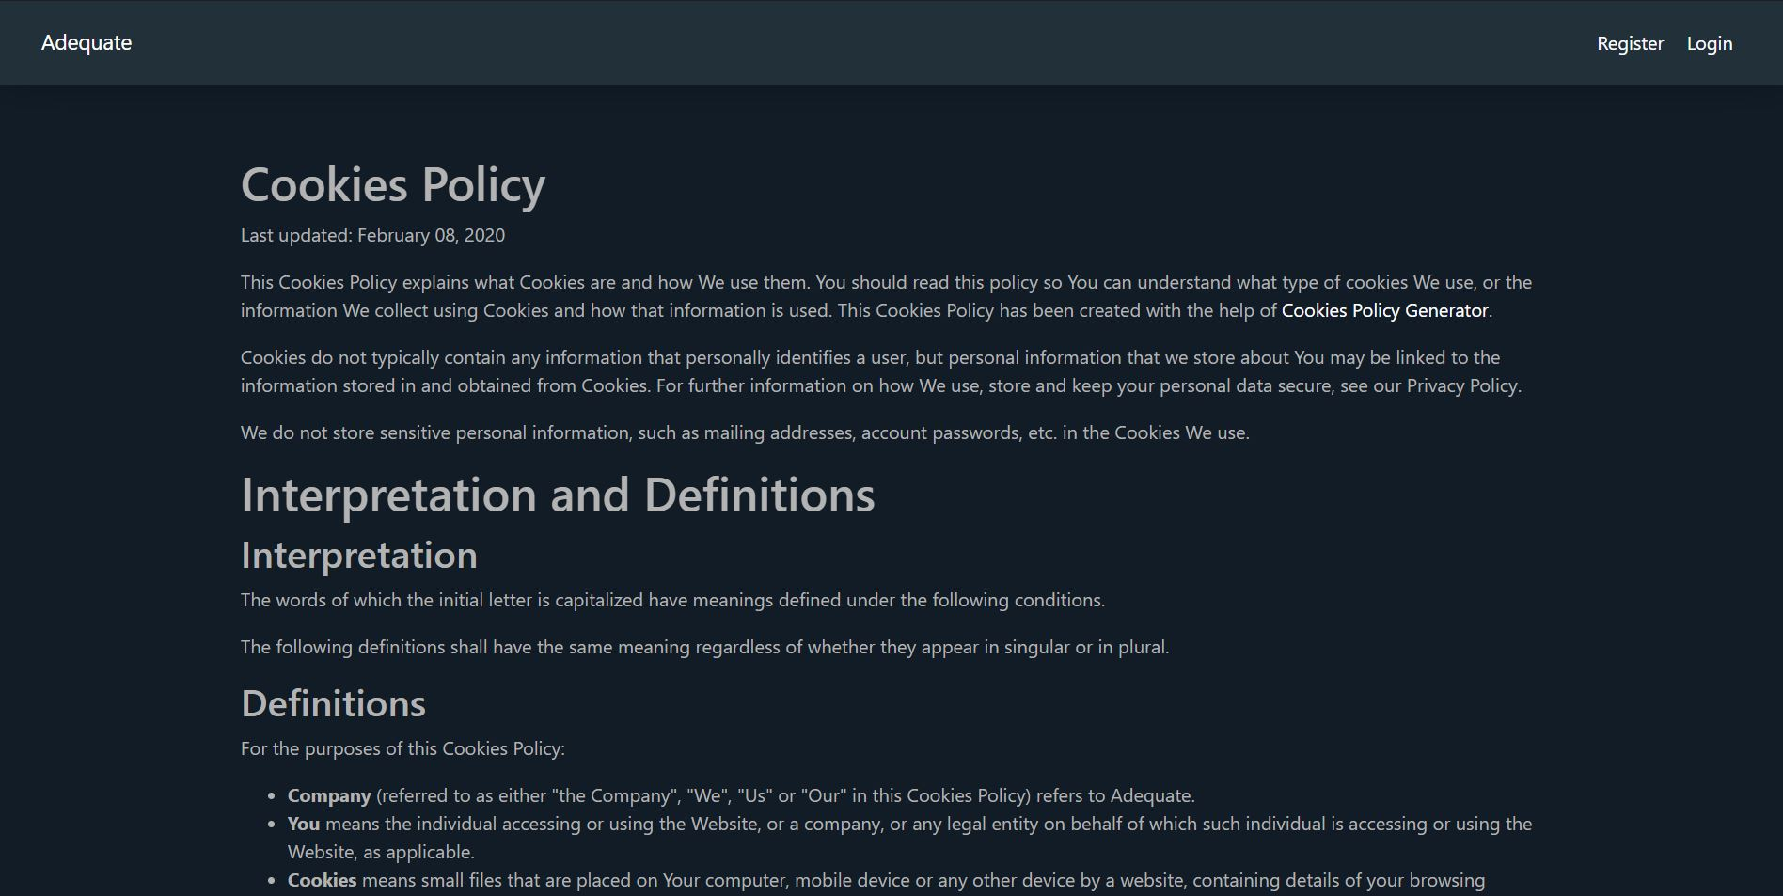
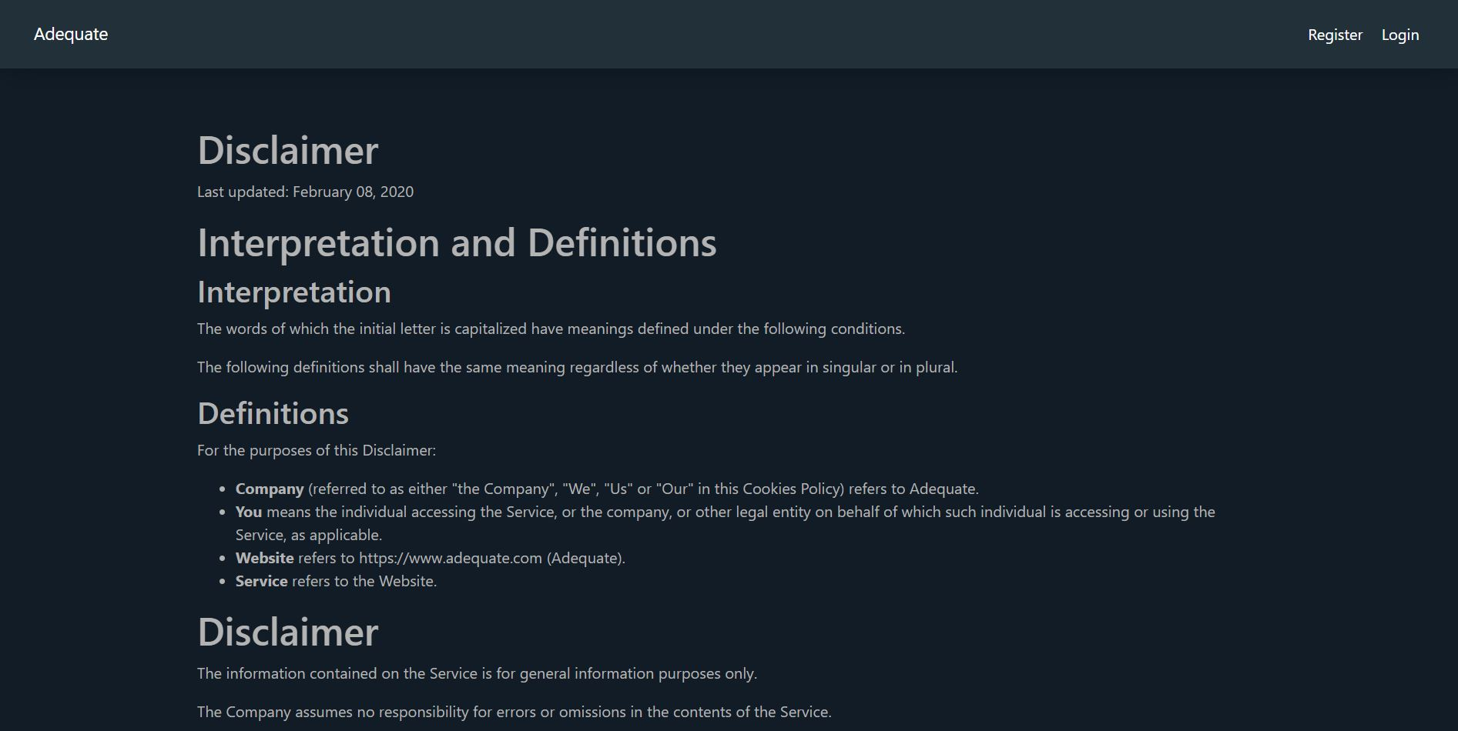
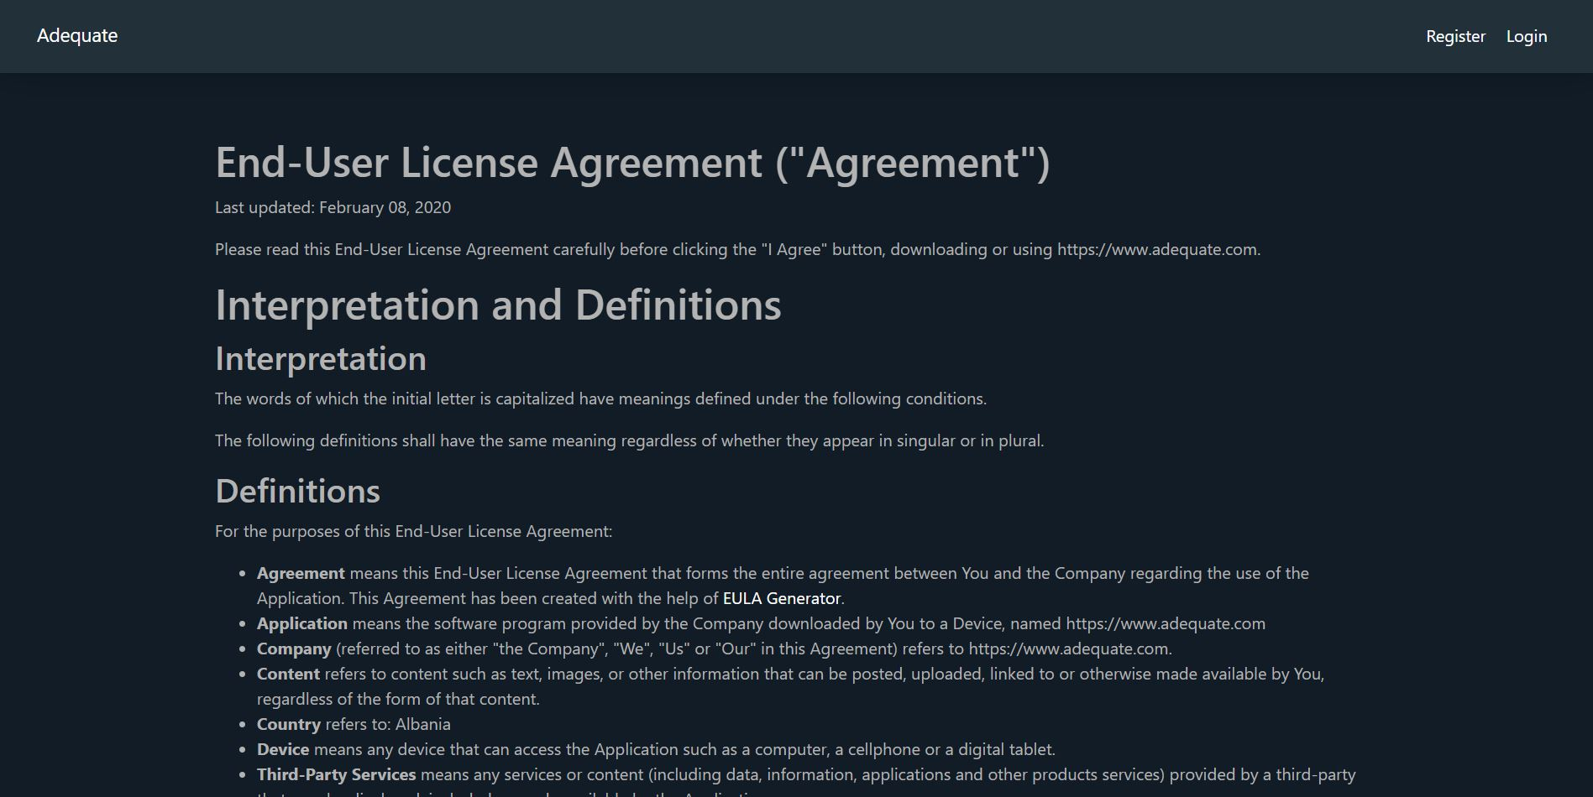
Running the Project
These are the Terms and Conditions, and Privacy Policy pages.

Slide 14
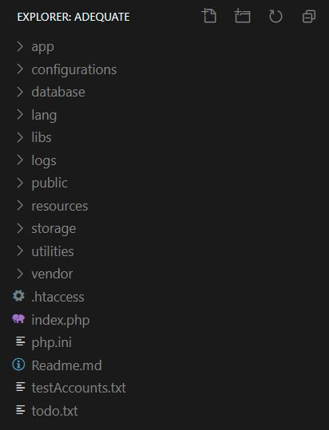
Directory Structure
After the installation, the Adequate project should have this project directory tree.

Slide 15
Directory Structure
app:
The ‘heart’ of the application live in this directory. This directory is autoloaded by the vendor\Router class, using its routing methods. All your Controllers and Model can be found here. Also here you can find some Helper files, Asset file callers, Form builders and CSRF Token generators.
configurations:
Contains all of your application’s configuration files.
database:
Contains your database .sql files, which will be imported into your DBMS.
lang:
Here you can place your language files for providing multi-language functionality in your system. Also here you can find some global variables which hold the error texts.

Slide 16
Directory Structure
libs:
One of the main features of this framework is the Packaging System. If you want to import external packages into your system without having to deal with all the messiness, you can place them all in one folder and we will do all the work for you. A class implementing Façade structural pattern, has all the methods you need to connect your library and use your library's functions throughout the system. It will instantiate all the classes in your package and you can access their instances statically.
logs:
All your errors are dumped in log files here, while your site is up and running.
public:
Contains all your assets such as CSS files, JS files and images.
resources:
All your views are placed here. They are contained inside a folder and have a custom JS file coming with them.

Slide 17
Directory Structure
storage:
It is the folder which holds all the user uploads.
utilities:
Inside you can find some utilities like ExternalSecurity which handles some security aspects like global variables security and error reporting system. There is also a FormValidator file which is responsible for validating your form inputs and a Middleware file which restricts users from accessing forbidden directories through the URL.
vendor:
This is the most important folder of the project. This is the heart of the project that does all the routing and stuff. Inside are found a BaseController, BaseModel, BaseView, Database file to connect to the database and implement CRUD functions implementing from the CRUDInterface interface. The Encrypt file to encrypt passwords before storing them to the database. Session file that provides functions to manage sessions. A GetComponent class to render views and connect with model files, and the last, but not the least, a Router file. This file does all the routing and moving through directories passed as parameters in the URL.

Slide 18
Directory Structure
Outside all the directories are the .htaccess file which restricts URL navigation, a php.ini file which disables all error reports, index.php which is the first one to open and does all the autoloading of the classes, Readme.md which explains the system briefly and testAccounts which holds some test accounts created initially, todo file which holds all the plans for the future and php.ini file which does an advanced handling of the errors.

Slide 19
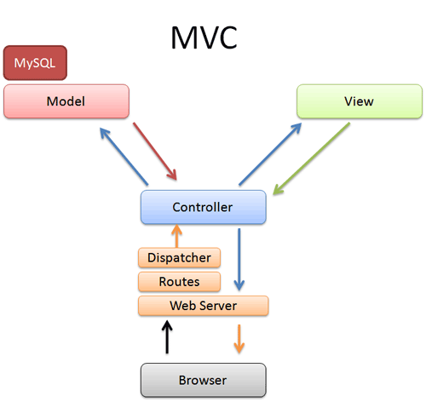
Model – View – Controller (MVC)
Schema of MVC Design Pattern.
A main advantage of MVC is separation of concern. Separation of concern means we divide the application Model, Control and View.
We can easily maintain our application because of separation of concern.
In the same time we can split many developers work at a time.

Slide 20
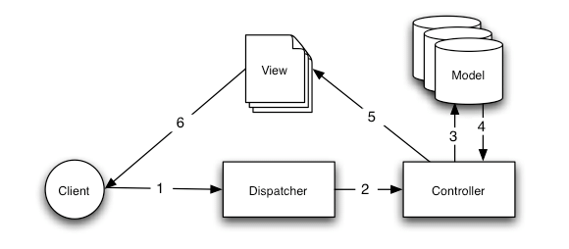
Model – View – Controller (MVC) (Briefly Explained)
The Client navigates through the URL to the system pages.
He sends a Request for a page. At that moment a Dispatcher mechanism defragments that URL and through a Router mechanism routes the Request to the right Controller component.
The Controller’s duty is to act as a bridge between the Model and the View components. So, the Controller calls the specific method from the Model.
The Model manipulates the Database data, through extending s a Database Class, where the last one, in our case, extends a PHP PDO class and also implements a CRUDInterface interface.

Slide 21
Model – View – Controller (MVC) (Briefly Explained)
The Model sends returns data back to its matching Controller component.
The Controller passes this data alongside the method which renders the matching View component.
The View provides a clean User Interface (UI) to the Client.
And this cycle repeats over and over, until the Client leaves the system.

Slide 22
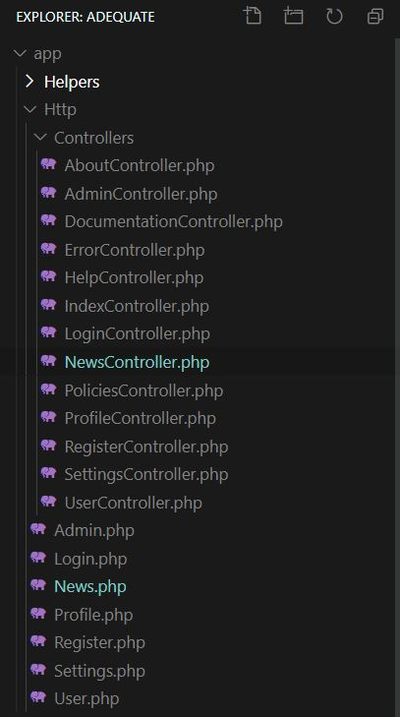
Creating Your First MVC Components (Controller + Model)
Create a new Controller in Controllers folder and the naming constraint for the Controller is as below:
<[Name]Controller.php>
If you want this component to have interactions with the Database (create, retrieve, update or delete data), then you should create a new Model with the naming constraints as below:
<[Name].php>
In our case, we have created a NewsController.php and a News.php, which will serve as our Model.

Slide 23
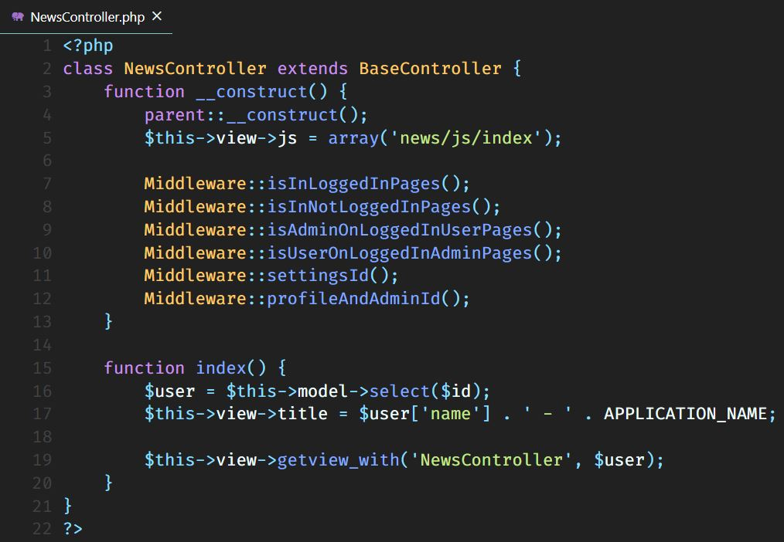
Creating Your First MVC Components (Controller + Model)
Here is a sample of a Controller class. It extends the BaseController and constructs what the parent class constructs. It sends a $js variable to the view, so you can directly communicate with the custom Javascript file inside your view folder. Above are some Middleware methods to restrict specific users to access specific components.

Slide 24
Creating Your First MVC Components (Controller + Model)
1st Middleware method restricts this component to be used if and only if you are logged in.
2nd Middleware method restricts this component to be used if and only if you are not logged in.
3rd Middleware method restricts this component to be used if and only if you own admin privileges.
4th Middleware method restricts this component to be used if and only if you are a regular user (not admin).
5th Middleware method should be placed only within the SettingsController class, but we placed it here in purpose of explaining all of the Middleware methods this system implements.
It restricts the Settings component to have an Id in the URL as a parameter.
6th Middleware method simply restricts the Profile and Admin classes to have an Id in the URL as a parameter.

Slide 25
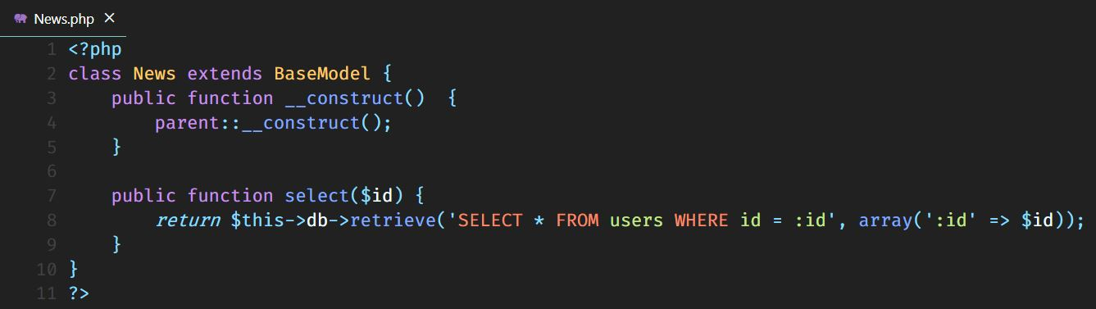
Creating Your First MVC Components (Controller + Model)
Below is shown a Model sample. It extends the BaseModel class and constructs what its parent class constructs.
It also has a method implementation of retrieving data from the database.

Slide 26
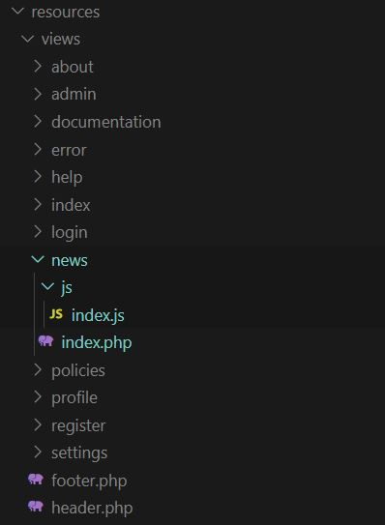
Creating Your First MVC Components (View)
To start giving life to the Controller and Model we just created, we should also create a View component.
To do this, we create a folder with the same name as the model, but lowercase letters.
Then, we create a folder named js with an index.js file inside. If you do not want this custom JS implementation, then don’t create this folder and don’t instantiate the $js variable in the Controller constructor also.
We create an index.php file which will hold our User Interface (UI).

Slide 27
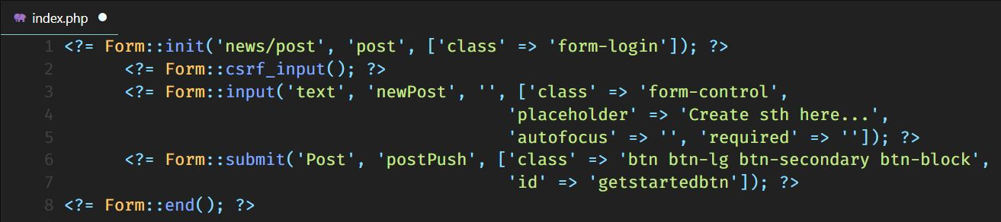
Creating Your First MVC Components (View)
Here is shown an example of a Post form, which is built using our tool, Form Builder.
As you can see creating forms in Adequate is simple and well-structured.
We have a Form Initialization tag, Form CSRF to prevent Cross Side Request Forgery, Form Input tag to create new user input fields, Form Submit tag to submit a request with the following data and a Form End to close the encapsulation of the above tags.

Slide 28
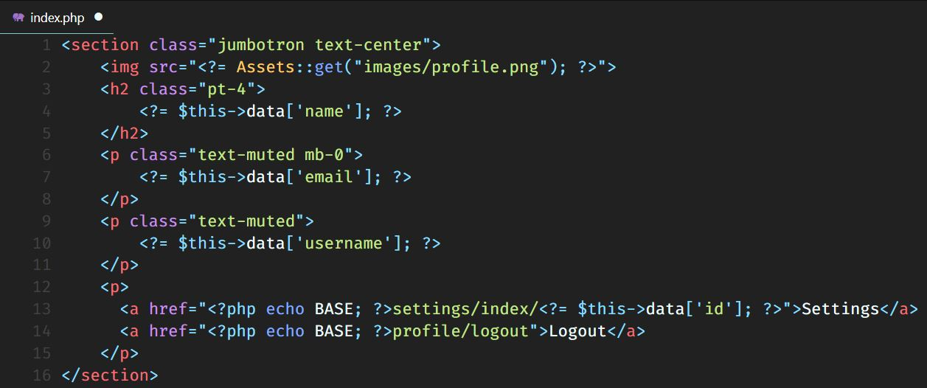
Creating Your First MVC Components (View)
Here we have another example of a View file, which basically gets the data passed in the controller and displays it in some HTML tags.

Slide 29
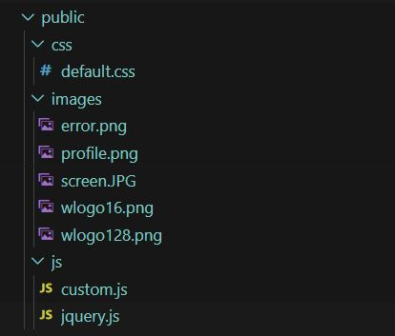
Creating Your First MVC Components (View)
Here you can upload all your assets like CSS files, JS files and images to be used inside the system.
These can be called with the
Asset::get(); static method.

Slide 30
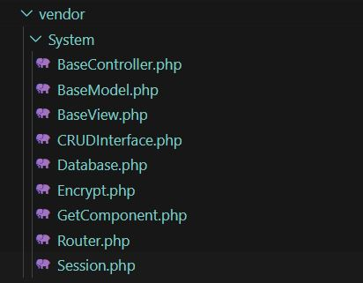
vendor\System Directory (Explained)
The Vendor Directory is the ‘brain’ of the whole framework.
It does all the Routing and Dispatching.
It keeps all the Base components and other important classes.

Slide 31
vendor\System Directory (Explained)
BaseController is the parent class of all the controllers found in: app\Http\Controllers directory.
BaseModel is the parent class of all the models found in: app\Http directory.
BaseView is the parent class of all the views found in: resources\views directory.
CRUDInterface is the interface, which holds all the CRUD methods.
Database is the class which implements the Singleton Creational Design Pattern and is responsible for the connection with the database and implementation of the CRUDInterface methods.

Slide 32
vendor\System Directory (Explained)
Encrypt is the class responsible for encrypting algorithms, used in encrypting the passwords before they are saved to the database.
GetComponent holds the methods which are used to provide a Model for a specific Controller and render views with or without passing arguments.
Router is the most important class in the vendor\System directory, because it does all the dispatching and routing of the URL. It directs users to the right Controllers and controllers to the right Models, with their right arguments.
Session class contains methods for starting, getting, setting and ending sessions.

Slide 33
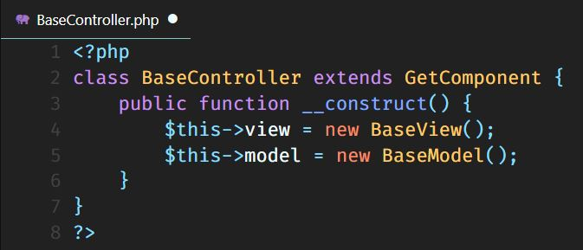
vendor\System Directory (Explained)
BaseController class extends the methods provided in the GetComponent class and instantiates the BaseView and BaseModel classes.

Slide 34
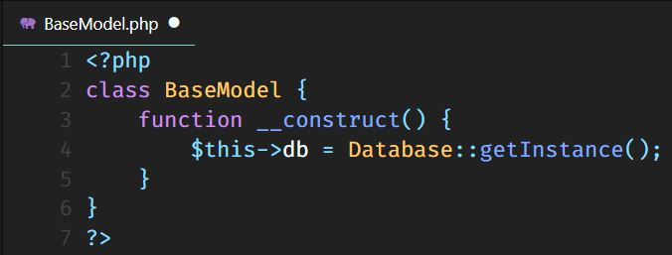
vendor\System Directory (Explained)
BaseModel class simply instantiates the Database class, through a getInstance() public method, since it implements the Singleton Pattern.

Slide 35
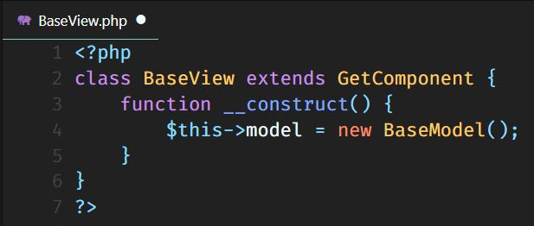
vendor\System Directory (Explained)
BaseView class extends the same class as BaseController and instantiates the BaseModel class.

Slide 36
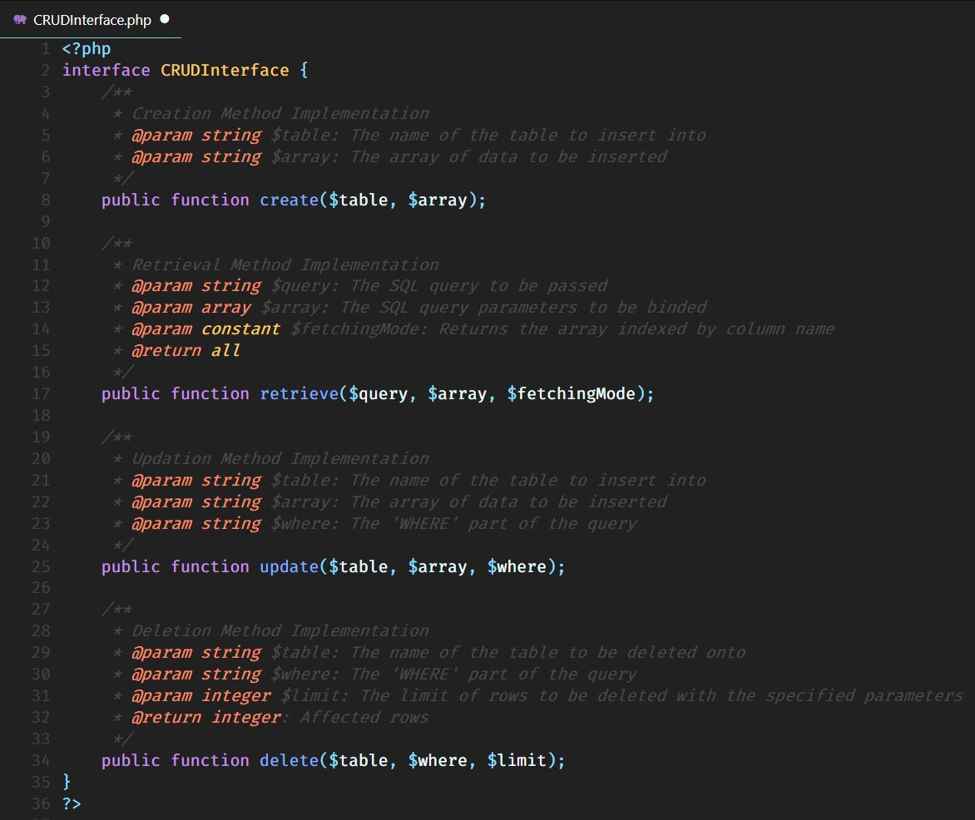
vendor\System Directory (Explained)
CRUDInterface, is an interface, which defines the methods to be used for manipulating the data in the database. CRUD stands for: Create, Retrieve, Update & Delete.
These four operations have different implementations, therefore take different parameters.
$table is the table name to be inserted into.
$array is the data passed in the form of the array.
$fetchingMode specifies how you want your result to be represented.
$where is the WHERE part of an SQL query.
$limit is the LIMIT part of an SQL query.

Slide 37
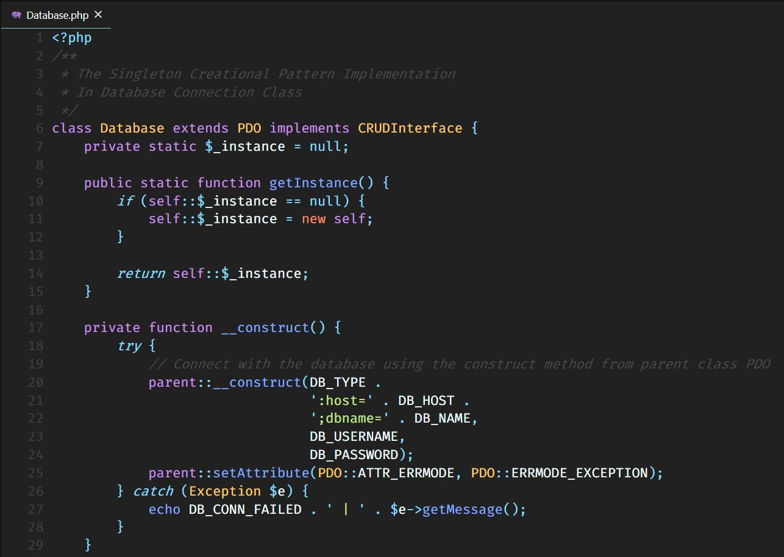
vendor\System Directory (Explained)
Database class, is a class which needs to be instantiated only one time, so to make this constraint possible, and over-instantiation impossible, we implement the Singleton Design Pattern.
We declare every method and instance as private, including the constructor, and we declare a static $_instance variable and a public static getInstance() method.

Slide 38
vendor\System Directory (Explained)
The $_instance variable will be used by the getInstance() method to check if the class is already instantiated. If it is instantiated, then it will just return the current instance of the class. Otherwise, it will create a new one.

Slide 39
vendor\System Directory (Explained)
In the constructor we establish a connection with the database, inheriting the methods in the PDO class it is extending.

Slide 40
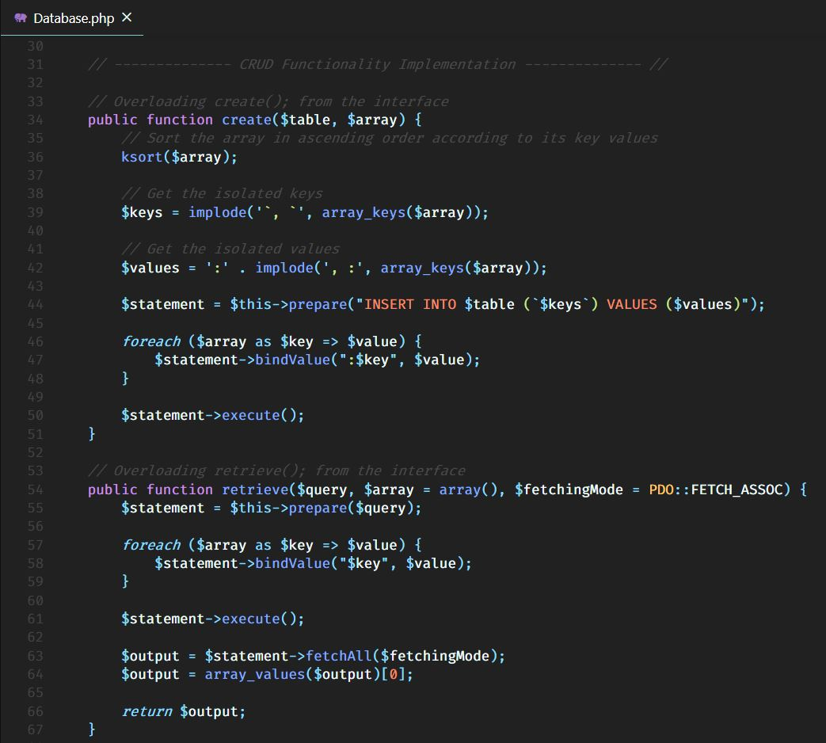
vendor\System Directory (Explained)
We also implement the methods, which are declared in the CRUDInterface interface, using the PDO class methods.
In the create() method, we first sort the array in ascending order according to the key values and remove the “`, `” after each element. We do the same thing for the values and then, we prepare the parameterized query, and bind the $key and $value variables as parameters. After doing this we execute the query.
The retrieval method is the same, except that the query should be passed as a parameter.

Slide 41
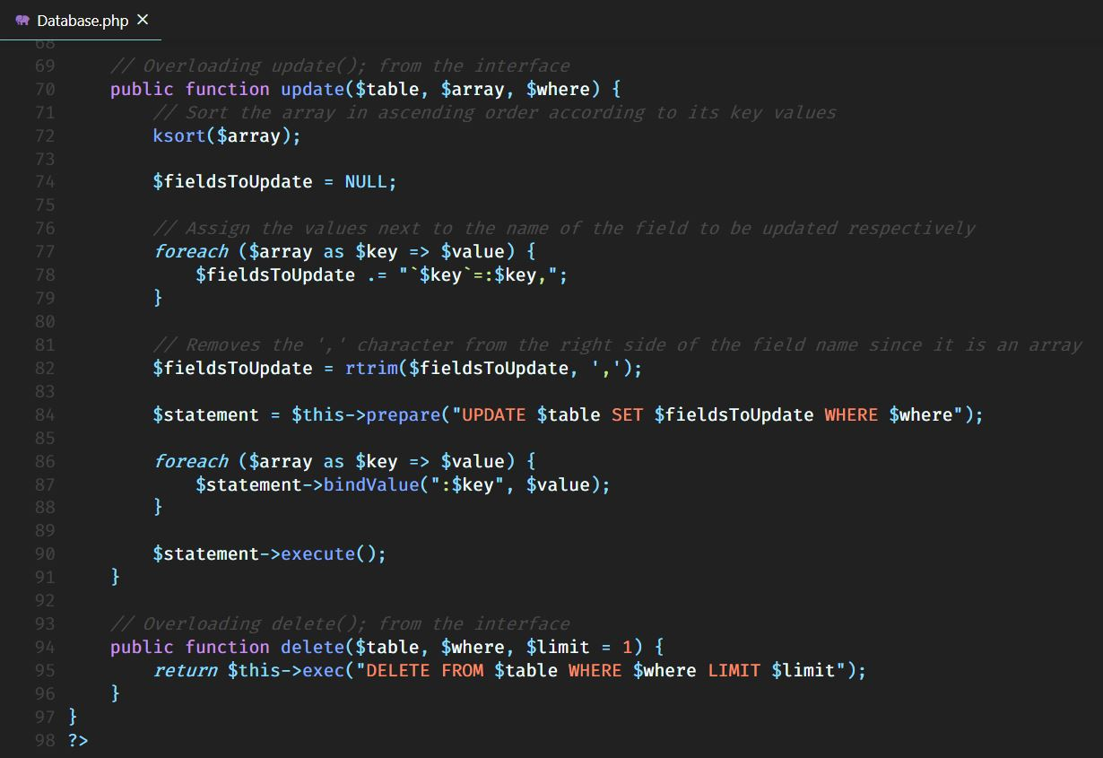
vendor\System Directory (Explained)
The update method is the same as create except, we pass the fields that we want to delete and the part after the WHERE clause.
The delete method simply takes the table name, part after the WHERE clause and the limit of rows to be deleted, which by default is 1. And after that it executes an SQL DELETE query.

Slide 42
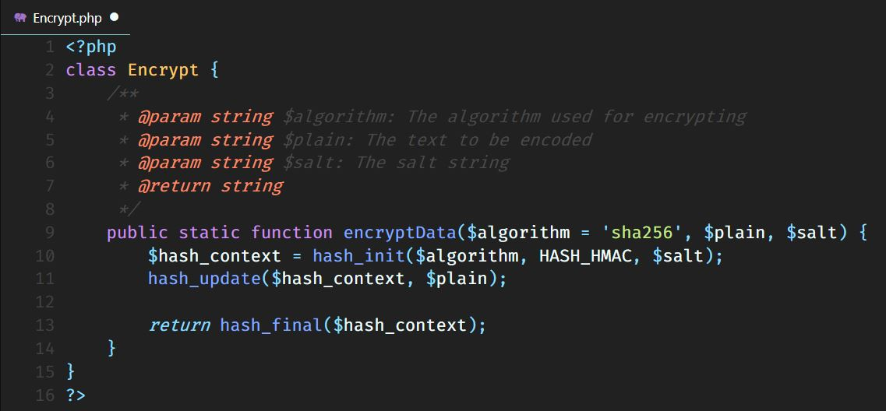
vendor\System Directory (Explained)
Encryption of the passwords before being inserted into the database, is done through the encryptData() method created in the Encrypt class.
You pass the algorithm you want, which by default is ‘sha256’ and you pass the data to be encrypted with a $salt to make it more secure.

Slide 43
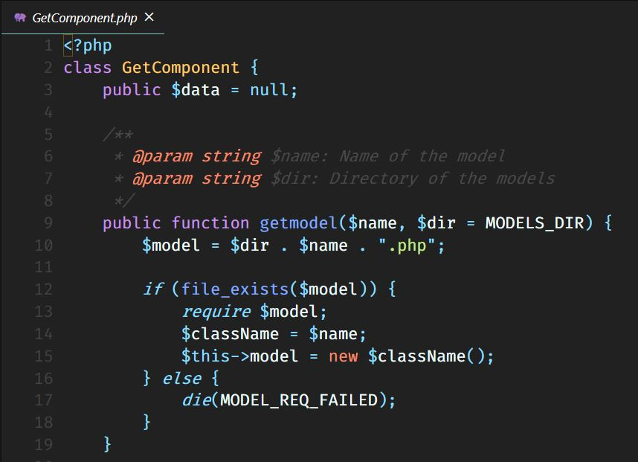
vendor\System Directory (Explained)
GetComponent class contains methods for retrieving models and views inside controllers.
The getmodel() method is passed the model name, constructs the path of the file, checks if it exists and instantiates it.

Slide 44
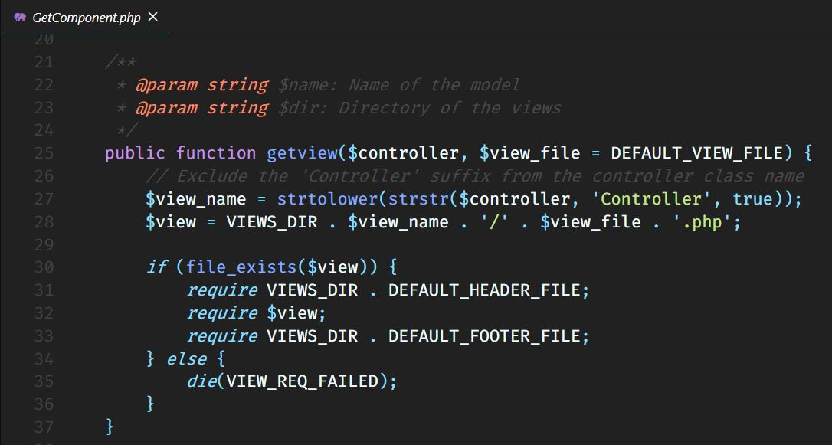
vendor\System Directory (Explained)
The getview() method is passed the controller name, which will be removed the ‘Controller’ part and lowercase its letters. Then it will be checked if it exists and require it between the requiring of the header and footer classes.

Slide 45
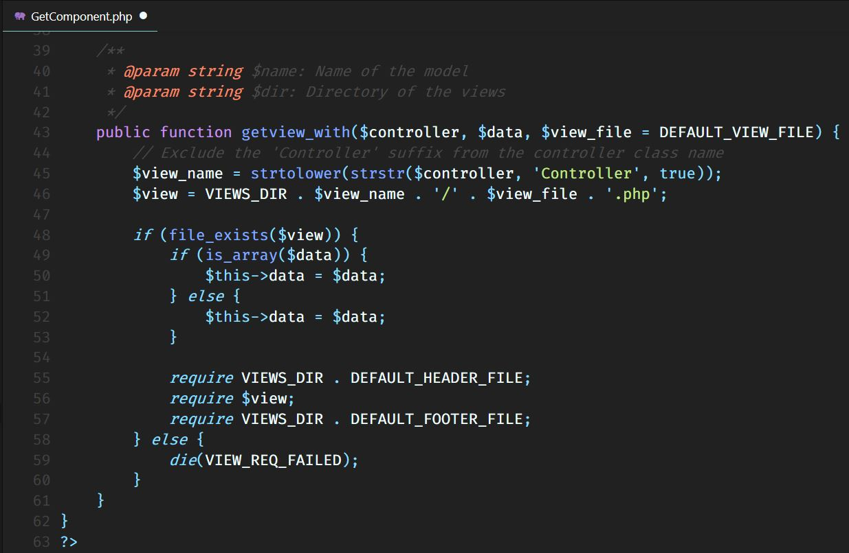
vendor\System Directory (Explained)
The getview_with() method does the same thing as getview(), except it also passes data to the $data public instance declared on top of the class, so we can access this data from the view, using $this keyword.

Slide 46
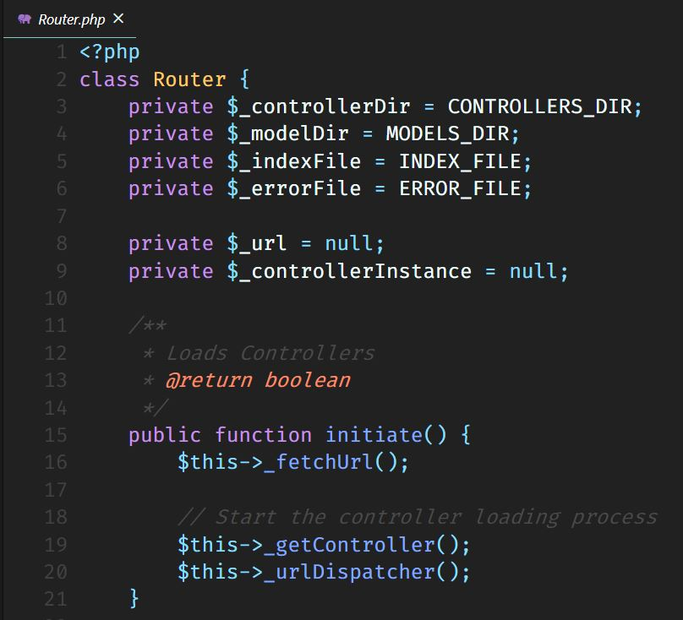
vendor\System Directory (Explained)
The router class simply, routes the Request sent by the user, to specific controllers, which may call their methods, with or without parameters.
The first function to start everything, is the initiate(), which is being called at index.php. Inside, it calls the private methods: _fetchUrl(), _getController() & _urlDispatcher().

Slide 47
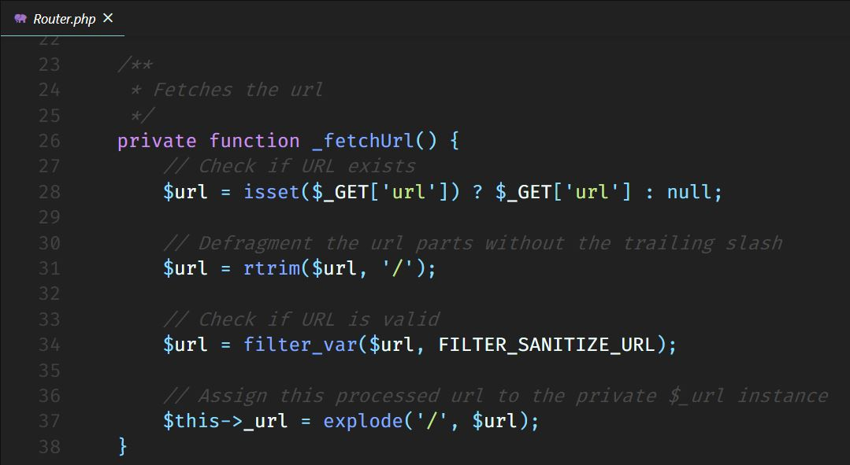
vendor\System Directory (Explained)
The _fetchUrl() method gets the URL, using the magic method $_GET[] and checks it if it is null. Then it removes the trailing slash after each part, and filters the URL if it is valid. After that it converts it to an array.

Slide 48
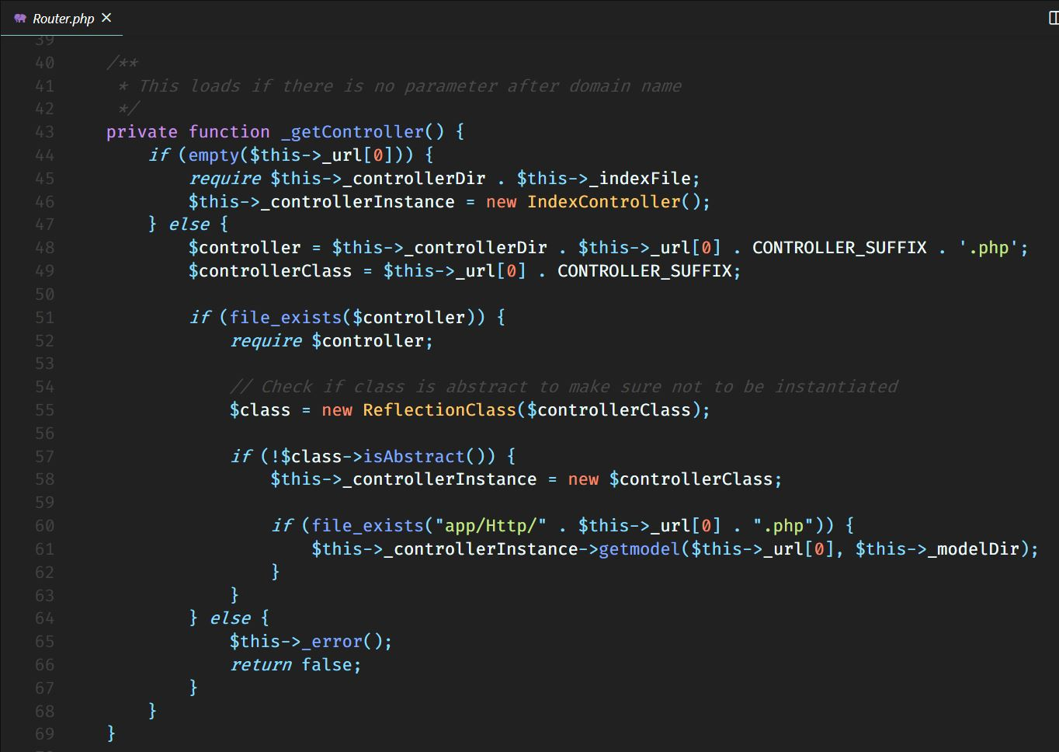
vendor\System Directory (Explained)
The _getController() method checks if the first part of the URL is empty and if it is, that means the user hasn’t opened any specific controller and is in the index page still, so it redirects the user to the default controller, which is the IndexController. Otherwise, it constructs the path to the controller passed in the first part of the URL, also constructs the controller class name. If this controller file exists, it requires it, then instantiates the controller class name, if and only if the class is not abstract. After doing that, it calls the getmodel() method from GetComponent class, which required and instantiated the model.

Slide 49
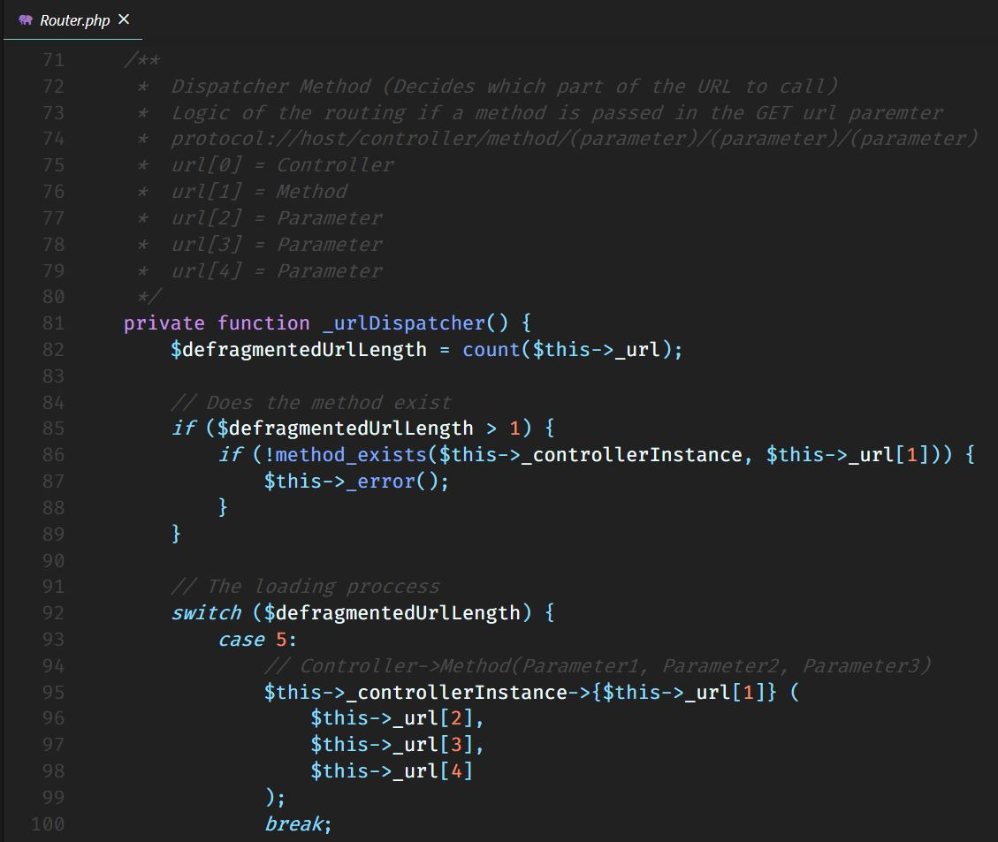
vendor\System Directory (Explained)
The _urlDispatcher() method, decides which part of the URL to call. It firstly counts the elements in the $_url array. If there are more than one elements that means that after the controller is passed a method name, but that doesn’t mean it exists, so we check if the method exists inside the $_controllerInstance class. Then we check for other parts in the URL. If there are 5 arguments passed, that means that after the controller and method name, there are other three arguments passed in the method as parameters.

Slide 50
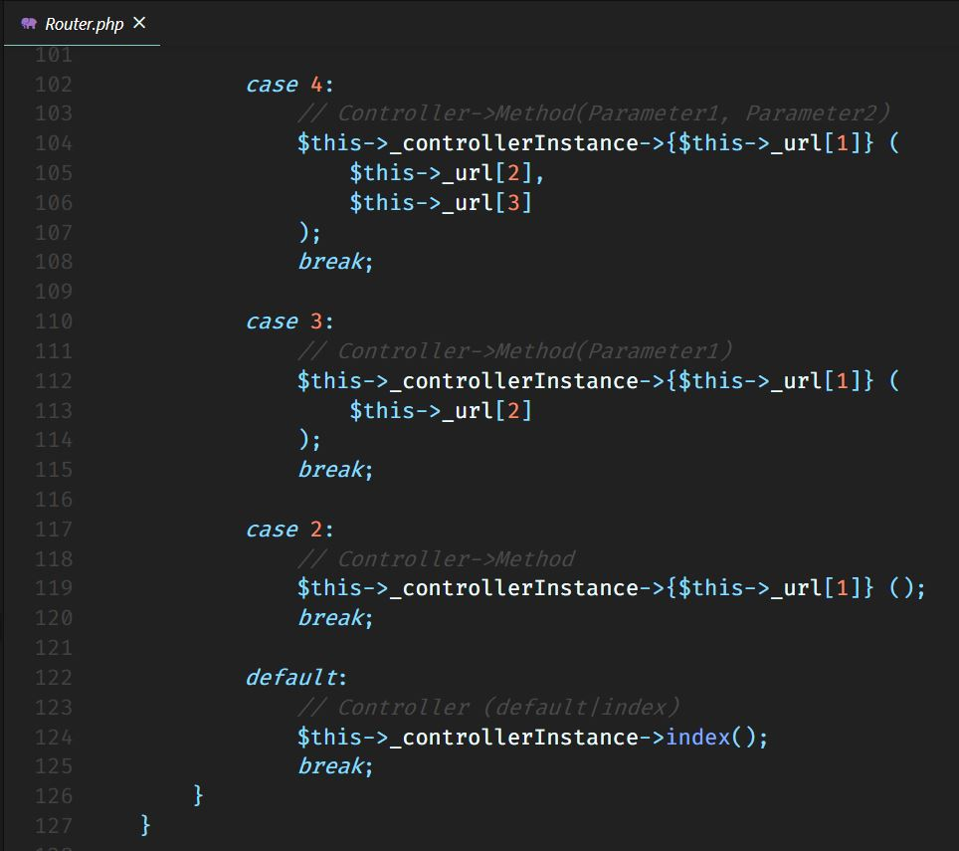
vendor\System Directory (Explained)
In case there are two arguments, one argument, or no arguments, we do the same thing, we instantiate the controller with the method, having parameters passed, or without parameters. Then if it is only the controller being passed, then we instantiate the controller and having no method, means it will call the index() method, found in every controller, and responsible for rendering the views.

Slide 51
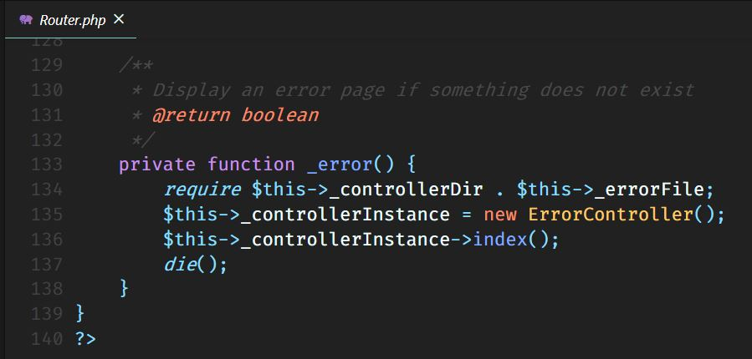
vendor\System Directory (Explained)
The _error() method redirects the user to the index() method of the ErrorController, and it is called when a controller or method does not exist.

Slide 52
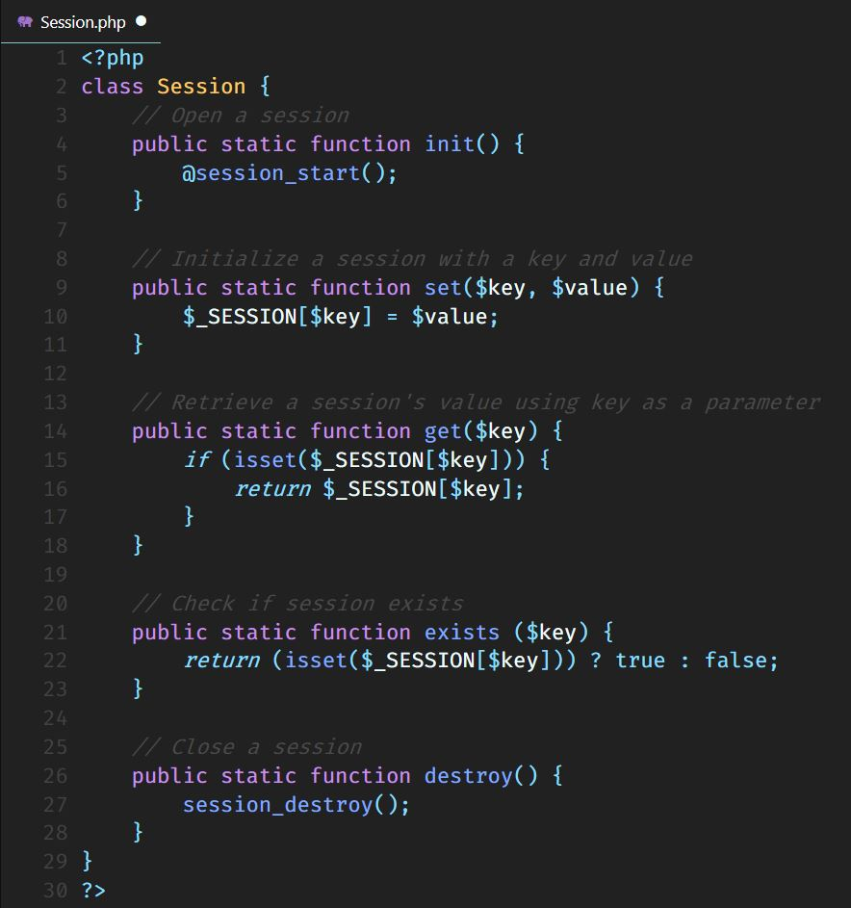
vendor\System Directory (Explained)
Session class is responsible for managing sessions.
The init() method starts a new session.
The set() method sets a key and value to the session.
The get() method gets the value of the current session using a key.
The exists() method checks if the session with that key exists.
The destroy() method, destroys the current session.

Slide 53
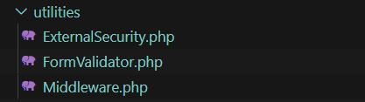
utilities Directory (Explained)
The utilities directory contains classes which are responsible for maintaining the security of the system.
Classes like ExternalSecurity, FormValidator & Middleware.

Slide 54
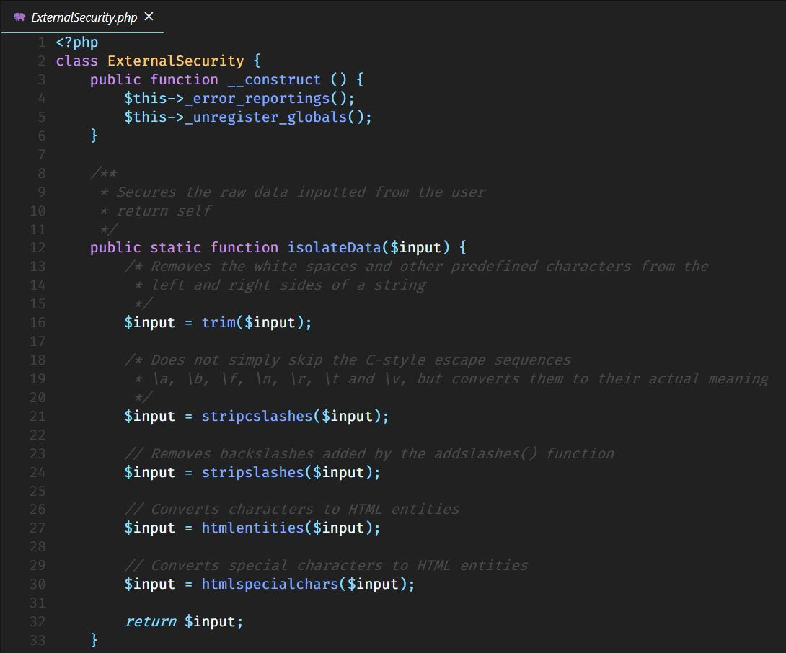
utilities Directory (Explained)
The ExternalSecurity class calls two methods in its constructor. The other one can be called statically.
The isolateData() method secures that the user does not enter data that contains malicious code like SQL Injection or code that can manipulate values in the system or database.

Slide 55
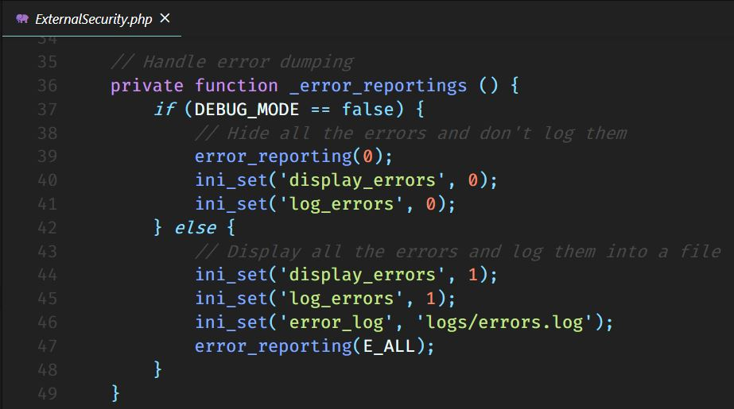
utilities Directory (Explained)
The _error_reportings() method chooses to report and dump the errors into a log file, or to shut them off if the system is up and running.

Slide 56
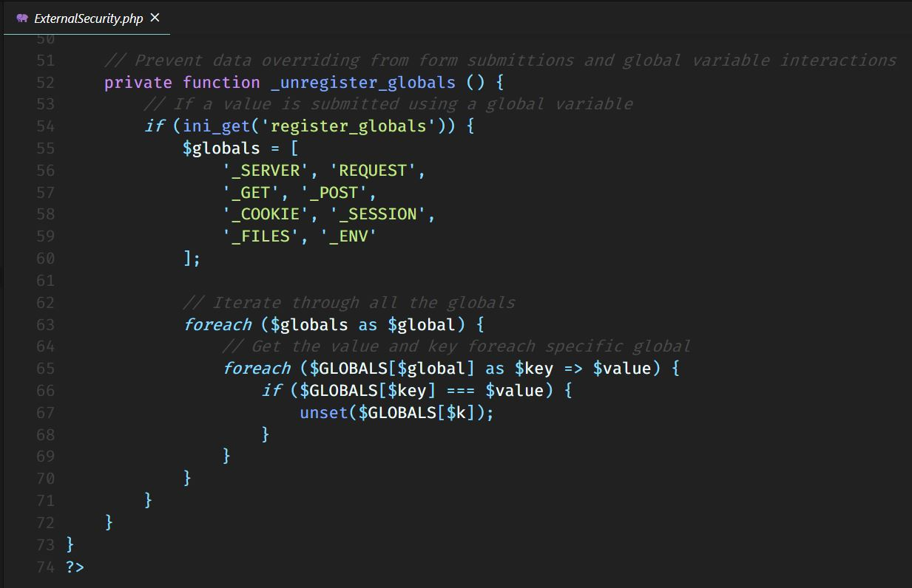
utilities Directory (Explained)
The _unregister_globals() method unregister global variables if they are over-written or deleted by any application. Any manipulation of these Superglobal values would drop the authenticity of the current request and would work against the intentional behavior of PHP.

Slide 57
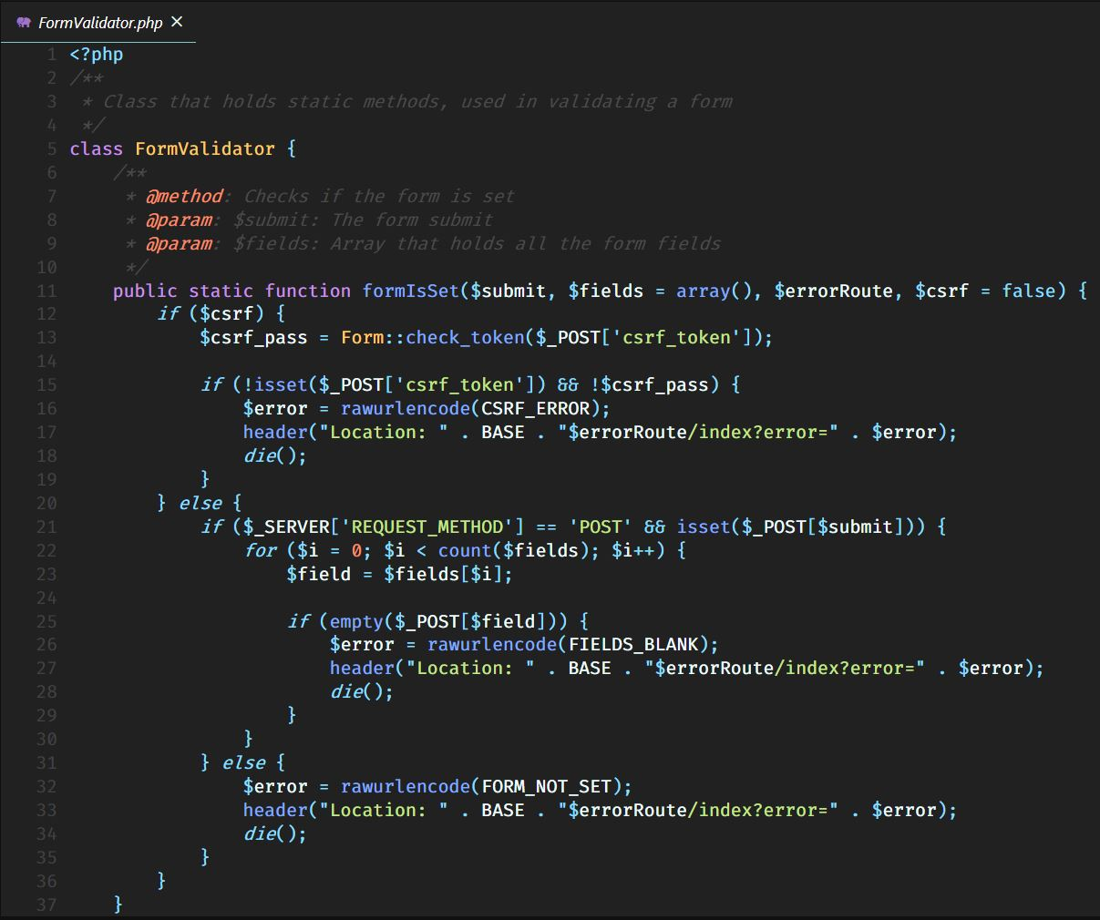
utilities Directory (Explained)
FormValidator class contains methods which validate the Request itself, or inputs inside the form using constraints.
These methods are called statically.
The formIsSet() method checks initially if $csrf is not set and the token has the same value as the one stored in session. Otherwise, checks if the server’s Request is of method POST and the form name is set. Then it checks each element of the data inputted if it set and not empty.

Slide 58
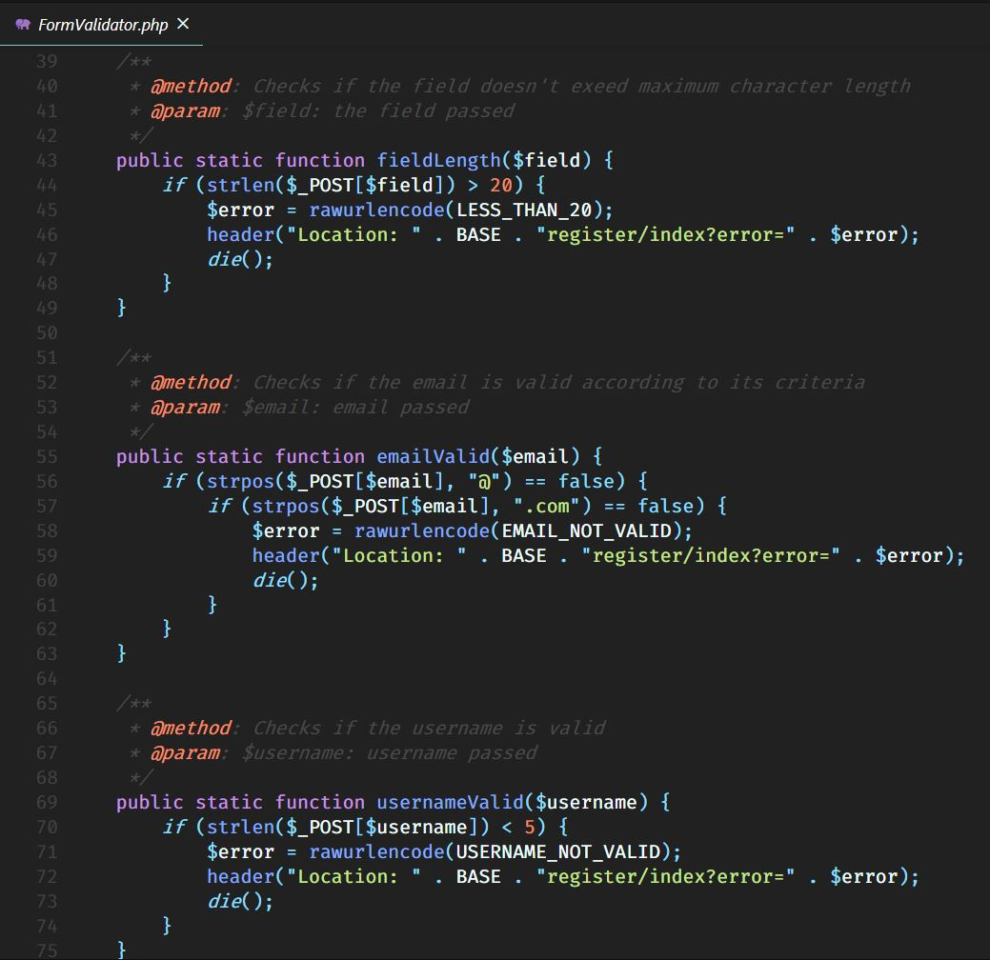
utilities Directory (Explained)
The fieldLength() method checks if the current field’s input doesn’t exceed a specific limit of characters.
The emailValid() method checks if the email contains an ‘@’ character also the ‘.com’ suffix.
The usernameValid() method checks if the username is greater than five characters.

Slide 59
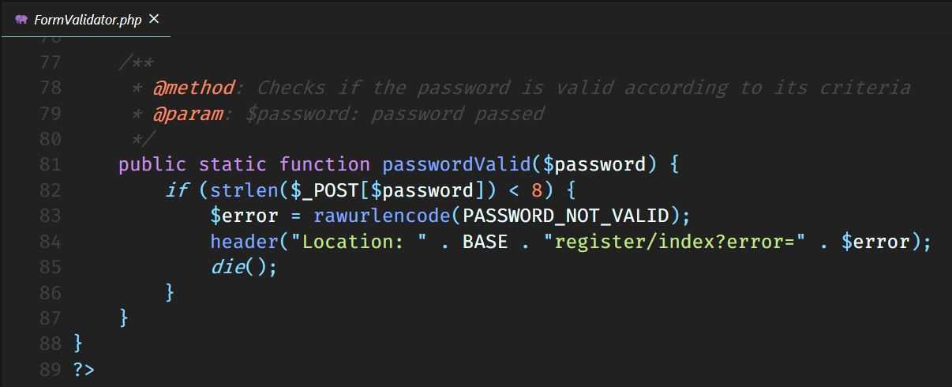
utilities Directory (Explained)
The passwordValid() method checks if the password doesn’t exceed 8 characters.

Slide 60

utilities Directory (Explained)
The Middleware class is responsible for restricting specific users access specific pages.
The start() method starts a session.
The isInNotLoggedInPages() method restricts this component to be used if and only if you are not logged in.

Slide 61

utilities Directory (Explained)
The isInLoggedInPages() method restricts this component to be used if and only if you are logged in.
The isAdminOnLoggedInUserPages() method restricts this component to be used if and only if you are a regular user (not admin).

Slide 62

utilities Directory (Explained)
The isUserOnLoggedInAdminPages() method restricts this component to be used if and only if you own admin privileges.

Slide 63

utilities Directory (Explained)
The settingsId() method should be placed only within the SettingsController class. It restricts the URL to have a parameter if it is the settings/index method.

Slide 64

utilities Directory (Explained)
The profileAndAdminId() method simply restricts the Profile and Admin classes to have an Id in the URL as a parameter.

Slide 65

logs Directory (Explained)
The logs directory holds log files which are responsible for dumping errors throughout the system.

Slide 66

logs Directory (Explained)
This is the errors.log file, in which are dumped all the errors that cannot be shown directly in the system because they occur during the runtime.

Slide 67

libs Directory (Explained)
The libs directory, contains an external directory in which you can put your libraries and access their methods through an interface provided in the LibraryFacade class, which implements the Façade Structural Pattern.

Slide 68

libs Directory (Explained)
The LibraryFacade class contains two private instances, one for the path of the libraries, the other for the library instance itself.
The connect_library() method takes the library name and an array of class names you want to instantiate in this library. To do this, it calls the import_library() method.

Slide 69
libs Directory (Explained)
Before importing, the library should be validated. The validate_library() method checks if a class name passed, starts capitalized.

Slide 70

libs Directory (Explained)
The import_library() method takes the library name and names of the classes you want to instantiate, and checks if library exists and require it.
Using inst() method, it instantiates each class inside the array.

Slide 71

lang Directory (Explained)
The lang directory holds all the global variables which define errors used through the system.
Also its purpose is to hold the language files used to make the system multi-lingual.

Slide 72

lang Directory (Explained)
The errors file defines all the globals which hold the error texts.

Slide 73

database Directory (Explained)
The database directory holds all the SQL files, which can be imported into your DBMS to create entities and relations.

Slide 74

database Directory (Explained)
The database.sql file creates a database named adequate if it does not exist.
Then it drops table admin if it already exists and creates a new one.
Admin has an id as primary key, unsigned integer which will be auto incremented. Name, email and password are varchars and cannot be null.

Slide 75

database Directory (Explained)
User has an id as primary key, unsigned integer which will be auto incremented. Name, email and password are varchars and cannot be null.

Slide 76

configurations Directory (Explained)
The configurations directory holds all the configuration files, that contain global directory names, or global file names, or database parameters and so on.

Slide 77

configurations Directory (Explained)
The config.php file contains globals like APPLICATION_NAME which is the name of the root folder. Even if you change the project folder name, all the occurrences of the app name will change dynamically without causing fatal errors or warnings.
It also stores the names of default components, file names, booleans, and encryption salt texts.

Slide 78

configurations Directory (Explained)
The database_params.php file simply holds the globals used to establish the database connection, like: database type, host, name, username & password.

Slide 79

app Directory (Explained)
The app directory is the ‘heart’ of the framework.
Here are placed all of your controllers, models and helper files, which give life to the project.
The Helpers folder will assist you with static methods for Form builders, and asset callers.
The Http folder contains all your models.
And the Http\Controllers folder contains all your controllers.

Slide 80

app Directory (Explained)
The Assets class contains a static method that will return the path for a file inside the public directory.

Slide 81

app Directory (Explained)
The Form class contains static methods to create HTML forms and HTML inputs fields, methods for securing forms by generating tokens and checking tokens, also creating hidden input fields.
The init() method takes action path, form method and arguments, and initializes a form.
The end() method simply ends a form, by putting a closing form tag.
The input() method initializes an input and assigns the input related attributes or the HTML attributes to it.

Slide 82

app Directory (Explained)
The submit() method returns a submit button and assigns the attributes to it.
The da() method defragments the attributes passed and concatenates them consecutively, adding the equal sign and the quotes after.
The generateToken() method generates a new random token.

Slide 83

app Directory (Explained)
The csrf_input() method returns a hidden HTML field with the value of the token which is generated at the time calling the generate_token() method.

Slide 84

app Directory (Explained)
Helpers class is a container for your custom helper methods.
The dump_data() method simply dumps the data in a readable form.
The url_encode_error() method returns the error in the form of a JS output.

Slide 85

app Directory (Explained)
The select method inside the Admin Model retrieves a record from table admin having that id, passed inside an array.

Slide 86

app Directory (Explained)
The Login Model contains methods for logging into the system, checking matching credentials in the database.
It firstly checks in the admin table and if it matches, it sets a session value to admin and redirects to his profile.

Slide 87

app Directory (Explained)
Otherwise it checks in the users table and does the same thing, except of the session value and redirect page.

Slide 88

app Directory (Explained)
The Profile Model does the same thing as Admin Model, except the fact that here you can put methods that suit only for the regular user.

Slide 89

app Directory (Explained)
The Register Model has methods related to registering users and only users, to the system.
The check username() and check_email() methods, check if the username and email crendentials exist somewhere in the users and admin table, before adding them.

Slide 90

app Directory (Explained)
If the credentials do not already exist, they are created in the database and a session is started and set, then the user will be redirected to his profile. Maybe you can even pass a message to the new users to welcome them to the system.

Slide 91

app Directory (Explained)
The Settings Model contains the same checking methods as the Register Model, since both of them create/update data to the database.
The Settings model also contains methods to retrieve admins and users.

Slide 92

app Directory (Explained)
The saveName(), saveEmail(), saveUsername(), savePassword() and delete() methods are used to update data and delete a user from the system.

Slide 93

app Directory (Explained)
User Model contains an abstract select() method to select users or admins from the database.

Slide 94


app Directory (Controllers’ Screenshots)
The Controller directory classes are all shown in the following slides.

Slide 95




app Directory (Controllers’ Screenshots)

Slide 96


app Directory (Controllers’ Screenshots)

Slide 97


app Directory (Controllers’ Screenshots)

Slide 98


app Directory (Controllers’ Screenshots)

Slide 99



app Directory (Controllers’ Screenshots)

Slide 100

Other files (Explained)
Other files in the system are .htaccess, index.php and php.ini files.

Slide 101

Other files (Explained)
The index.php file is the first one to open.
It requires some initial files like configuration files and error file.
Then autoloads all the classes inside the directories passed in an enhanced for loop, so they are registered automatically.
Then an instantiation of the ExternalSecurity class and Router class is done.
The last one and the most important is the initiate() method calling. That method call will do the rest we explained earlier in the Router class.

Slide 102



Other files (Explained)
The .htaccess and php.ini files shown below, are responsible for preventing the user to access forbidden 403 pages and for shutting all the error reports down.

Slide 103

UML Diagrams (Directory Diagram)

Slide 104


UML Diagrams (Class Diagram)

Slide 105

UML Diagrams (Class Diagram)

Slide 106


UML Diagrams (Class Diagram)

Slide 107

UML Diagrams (Class Diagram)

Slide 108


UML Diagrams (Class Diagram)

Slide 109


UML Diagrams (Class Diagram)

Slide 110
Other Information
Concepts which helped in developing this framework:
From PHP Language:
Routing URLs
CSRF (Cross-Site Request Forgery) Tokens
PDO (PHP Data Objects) Database Connection
Autoloader methods
Form builder
Query builder (CRUD)
Form Validator
Middleware
Other security aspects (global variables and error reporting)
Authenticating (Login & register)

Slide 111
Other Information
From Object Oriented Programming (OOP) Paradigm:
Classes & Objects (Static classes, constructors)
Inheritance & Composition
Interfaces & Abstraction
Static & Dynamic Polymorphisms
From Software Architecture (Design Patterns):
Singleton Creational Pattern
MVC Architectural Pattern
Façade Structural Pattern

Slide 112
Other Information
Project Specifications
PHP Version: 7.3.10
Bootstrap Version: 4.1.1
Visual Studio Code Version: 1.42.0 x64
Apache/2.4.33 (Win32) OpenSSL/1.1.0h PHP/7.2.5 Server at localhost Port 80
Size: 559 KB (484,750 bytes)
Contains: 81 Files, 44 Folders

Slide 113
Adequate
Creator: Gerald Nika.

